Slide 1
JAVA FS : ECE & EIE 3rd Year
DAY 16
Arrays

Slide 2
Java Arrays
Advantage of Java Array
Code Optimization: It makes the code optimized, we can retrieve or sort the data easily.
Random access: We can get any data located at any index position.
Disadvantage of Java Array
Size Limit: We can store only fixed size of elements in the array.
It doesn't grow its size at runtime.
To solve this problem, collection framework is used in java.
Types of Array in java
There are two types of array.
Single Dimensional Array
Multidimensional Array

Slide 3
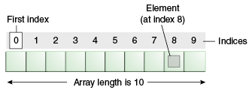
Java Arrays
Array is a collection of similar type of elements that have contiguous memory location.
Java array is an object the contains elements of similar data type. It is a data structure where we store similar elements. We can store only fixed set of elements in a java array.
Array in java is ZERO index based, first element of the array is stored at 0 index.

Slide 4
Java Array
Single Dimensional Array in java
Syntax to Declare an Array in java
dataType[ ] arr; (or)
dataType [ ]arr; (or)
dataType arr[ ];
Data Type Var = new Data Type[size]
class FsN1Array
{
public static void main(String args[])
{
int a[ ]=new int[1];//declaration
a[0]=10;//initialization
float[ ] b = {18.9f}; //Declaration and initialization
char [ ]c= new char[1];
c[0] = 'a';
//printing array elements & length propery
System.out.format("%d",b.length);//length is the property of array
System.out.println(
System.out.println(a[0]);
System.out.println(b[0]);
System.out.println(c[0]);
}
}

Slide 5
Java Array
Passing Array to method in java

Slide 6
Java Array
class FsN3Arrays //passing array to fn
{
static void sort(int a[])//sorting array
{ int t;
for (int i = 0; i < a.length; i++)
{
for (int j = i + 1; j < a.length; j++)
{
if (a[i] > a[j])
{ t = a[i]; a[i] = a[j];
a[j] = t;
}
}
}
System.out.print("Ascending Order:");
for (int i = 0; i < a.length; i++)
{ System.out.print(a[i] + ","); }
}
public static void main(String args[])
{
int a[]={33,3,4,5};
sort(a);//passing array to method
for (int i = 0; i < a.length; i++)
{ System.out.print(a[i] + ","); }
}
}

Slide 7
Java Array
/*
WAJP which uses IS-A and HAS-A relation. The base class should have a constructor which populates 5 elements of int type by every time prompting the message
"enter element: "
and the user should dynamically enter int values during run time.
Create an IS-A relation which should identify the min value in the array and display that element
min element: -7
Then using a HAS-A relation pass the array to the function, identify and display the element which has max value in the array
max element: 77
*/

Slide 8
Java Array
import java.util.Scanner;
class BaseClass
{
int arr[] = new int[5];
BaseClass()
{ Scanner s = new Scanner(System.in);
for(int i=0;i<arr.length;i++)
{ System.out.println("enter element: ");
arr[i] = s.nextInt();
}
}
}
class Min extends BaseClass
{
Min()
{ min(arr); }
public void min(int arr[])
{ int mini=arr[0];
for(int i=1;i<arr.length;i++)
if(mini>arr[i])
mini=arr[i];
System.out.println("min element: "+mini);
Max m = new Max();//HAS A relation
m.max(arr);
}
}
class Max
{
public void max(int arr[])
{
int maxi=arr[0];
for(int i=1;i<arr.length;i++)
if(maxi<arr[i])
maxi=arr[i];
System.out.println("max element:
"+maxi);
}
}
public class FsN2Array
{
public static void main(String args[])
{
Min m = new Min();
}
}

Slide 9
Java Arrays
Multidimensional array in java
In such case, data is stored in row and column based index (also known as matrix form).
Syntax to Declare Multidimensional Array in java
dataType[][] arrayRefVar; (or)
dataType [][]arrayRefVar; (or)
dataType arrayRefVar[][]; (or)
dataType []arrayRefVar[];
int[][] arr=new int[3][5];//3 row and 5 column
int arr[][]={{1,2,3},{2,4,5},{4,4,5}};

Slide 10
Java Arrays
/* WAJP using a single class. Declare and initialize two 2x3 arrays
Creating another matrix to store the sum of two matrices
Adding and printing addition of 2 matrices in a matrix type of display
2 6 8
6 8 10
*/

Slide 11
Java Arrays
public class FsN4Arrays
{
public static void main(String args[])
{
//creating two matrices
int a[][]={{1,3,4},{3,4,5}};
int b[][]={{1,3,4},{3,4,5}};
//creating another matrix to store the sum of two matrices
int c[][]=new int[2][3];
//adding and printing addition of 2 matrices
for(int i=0;i<2;i++)
{
for(int j=0;j<3;j++)
{
c[i][j]=a[i][j]+b[i][j];
System.out.print(c[i][j]+" ");
}
System.out.println();//new line
}
}
}

Slide 12
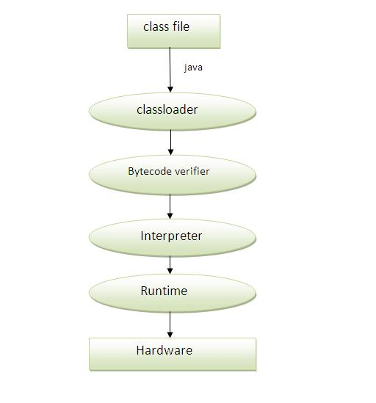
What happens at runtime?
At runtime, following steps are performed:
Classloader: is the subsystem of JVM that is used to load class files.
Bytecode Verifier: checks the code fragments for illegal code that can violate access right to objects.
Interpreter: read bytecode stream then execute the instructions.

Slide 13
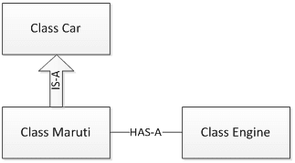
Example
class Maruti extends Car //Sub Class
{
public void MarutiStartDemo()
{
Engine MarutiEngine = new Engine();
//Has A relationship
MarutiEngine.start();
}
}
public class FsM1HasA
{
public static void main(String args[])
{
Maruti m = new Maruti();
m.MarutiStartDemo();
m.setColor("Red");
m.setMaxSpeed(120);
m.carInfo();
}
}
HAS A
class Engine
{
public void start()
{ System.out.println("Engine Started:"); }
public void stop()
{ System.out.print("Engine Stopped:"); }
}

